Slide 2
Lab 5 – Track 1 – Randomization
Sakina Shibuya & Kristoffer Bjärkefur
20 June 2018

Slide 3
Key Terms
Treatment and Control
Treatment means receiving the project
control means not receiving the project
Treatment Arms
If there are multiple versions of the intervention, each group receiving a different version of the project is called a treatment arm.

Slide 4
Types of Randomization
Simple
Each individual person is assigned either T or C
Cluster
Randomization happens on group level (village, school etc. ) and all individuals in a group are assigned the same treatment
Stratified
Sub-sets of similar observations (rich/poor, male/female etc.) are determined in advance, and randomization is done separately within each sub-set
Guarantees that equal number of similar observations (rich/poor, male/female etc.) are assigned to be each treatment and control
Pairwise
Extreme form of stratification
All units are matched to make pairs that are as similar as possible and one unit from each pair is assigned to be T or C

Slide 5
Why do we randomize?
“Random” does not imply “completely random”, we want a controlled randomization
We want to assign the intervention of our projects so that the control group is as similar as possible to the treatment group as possible
This is called a balance treatment assignment
Randomization is the most common tool to achieve that
Each observation needs to have the same probability to end up in the each treatment arm, and all members in a strata need to be statistically similar

Slide 6
Methods of randomization
Good:
Field Based
Stata, R, Python – and other replicable software
Bad:
Excel – and other non-replicable software
Excel and many other software has random generators, but they do not allow a controlled randomization

Slide 7
Method: Field Based
Examples
Drawing numbers from a hat, flipping a coin etc.
Advantages
Transparent to participants
Allows randomization without exactly knowing treatment population in advance
Disadvantages
Not transparent to anyone not present
Not replicable
Difficult to manage any a complex randomization with, for example, stratification

Slide 8
Method: Stata
Advantages
Fully replicable
Relatively easy to set up complex randomizations
We can run a test randomization and analyze the outcome before we draw new random numbers for the actual randomization
Disadvantages
Can seem very mysterious to beneficiaries and project staff

Slide 9
Prepare randomization in Stata
Obtain a list of observations to be randomized
Define a randomization rule
How many units (people) are in the population?
How many treatment arms do you have?
How big share of the observations should end up in each group?
Are we using stratification?
Which variables will we use to test balance?
Randomize and document using Stata!

Slide 10
Ex 1: Basic Randomization in Stata
We have 10 students and we want half of them to be treatment and control
What is our randomization rule?
How do we do this in Stata so it is random but replicable?

Slide 11
Simplified example of randomization
Start with a sorted list of observations you want to randomize. Generate a random number.
Sort the observations after this random number. The order of the observations are now randomly sorted.
Assign 0 (control) to the first half of the observations, and assign 1 (treatment) to the second half.
1
2
3
HH_ID
AAAA
BBBB
CCCC
DDDD
EEEE
FFFF
GGGG
HHHH
IIII
JJJJ
HH_ID | rand
AAAA | .10
BBBB | .50
CCCC | 1.0
DDDD | .20
EEEE | .80
FFFF | .90
GGGG | .70
HHHH | .40
IIII | .60
JJJJ | .30
HH_ID | rand
AAAA | .10
DDDD | .20
JJJJ | .30
HHHH | .40
BBBB | .50
IIII | .60
GGGG | .70
EEEE | .80
FFFF | .90
CCCC | 1.0
HH_ID | rand | tmt
AAAA | .10 | 0
DDDD | .20 | 0
JJJJ | .30 | 0
HHHH | .40 | 0
BBBB | .50 | 0
IIII | .60 | 1
GGGG | .70 | 1
EEEE | .80 | 1
FFFF | .90 | 1
CCCC | 1.0 | 1

Slide 12
The 3 rules of replicable randomization
We want to be able to replicate the randomization and get the same results each time. This is needed for research transparency
To achieve that in Stata we have three rules:
Set the version of Stata
Set the seed
Stable sort
The next slides explains the meaning of these rules and why it matters

Slide 13
Rule 1: Set the version of Stata
Stata 11 | 1st | 2nd | 3rd | 4th | 5th | 6th | 7th | 8th
 | 0.625 | 0.000 | 0.125 | 0.375 | 0.250 | 0.875 | 0.500 | 0.750
Stata 12 | 1st | 2nd | 3rd | 4th | 5th | 6th | 7th | 8th
 | 0.625 | 0.500 | 0.875 | 0.000 | 0.375 | 0.125 | 0.250 | 0.750
Stata 13 | 1st | 2nd | 3rd | 4th | 5th | 6th | 7th | 8th
 | 0.250 | 0.625 | 0.125 | 0.750 | 0.875 | 0.500 | 0.000 | 0.375
Stata has pre-calculated list of random numbers. However, these lists differs between versions of Stata.
For our purposes, all these lists are equally good, but we need to pick one. You can set Stata to use an older list but not a newer
In reality these lists are billions of items long, instead of 8 as in the example above

Slide 14
Rule 1: Set the version of Stata
Stata 12 | 1st | 2nd | 3rd | 4th | 5th | 6th | 7th | 8th
 | 0.625 | 0.500 | 0.875 | 0.000 | 0.375 | 0.125 | 0.250 | 0.750
HH_ID | rand
1001 | 0.625
1002 | 0.500
1024 | 0.875
2027 | 0.000
2028 | 0.375
Stata goes through the lists and assigns the 1st value to the first observation, 2nd to the second observation, etc.

Slide 15
Rule 2: Set the seed
Stata 12 | 1st | 2nd | 3rd | 4th | 5th | 6th | 7th | 8th
 | 0.625 | 0.500 | 0.875 | 0.000 | 0.375 | 0.125 | 0.250 | 0.750
HH_ID | rand
1001 | 0.875
1002 | 0.000
1024 | 0.375
2027 | 0.125
2028 | 0.250
Setting the seed change the starting place in the list
Randomly selecting a seed means randomizing the starting point
If no seed is set, a seed is randomized each time you run the code, this means random but not replicable

Slide 16
Rule 3: Stable sort
Stata 12 | 1st | 2nd | 3rd | 4th | 5th | 6th | 7th | 8th
 | 0.625 | 0.500 | 0.875 | 0.000 | 0.375 | 0.125 | 0.250 | 0.750
Ascending sort
HH_ID | rand
1001 | 0.875
1002 | 0.000
1003 | 0.375
Descending sort
HH_ID | rand
1003 | 0.875
1002 | 0.000
1001 | 0.375
The two data sets to the left are sorted differently, and while the same random numbers were picked, the result of the randomization is different.
Adding and removing observations can change the sort order

Slide 17
The 3 rules of replicable randomization
Rule 1: Set version
Rule 2: Set the seed
Stata 12 | 1st | 2nd | 3rd | 4th | 5th | 6th | 7th
 | 0.625 | 0.500 | 0.875 | 0.000 | 0.375 | 0.125 | 0.250
Rule 3: Stable sort
HH_ID | rand
1001 | 0.875
1002 | 0.000
1024 | 0.375
2027 | 0.125
2028 | 0.250

Slide 18
3 rules for replicable randomization
Set the version of Stata
Guarantees the same list of random numbers
See commands ieboilstart or version in Stata
Set the seed
Guarantees the same starting point in that list
See command set seed. Randomize a seed at least 6 digits long (for example at www.random.org)
Stable sort
Guarantees that the same observation gets the same random number from the list
Sort the data in way that will remain constant even if someone else change the sort order of the data set you are using
Be aware that changing the data set, adding or removing observations, changes the sort order!

Slide 19
Ex 1: Basic Randomization in Stata
Open endline_data_raw.dta
We have 1067 households and we want half of them to be treatment and control
What is our randomization rule?
Let’s see an example of a replicable randomization of this

Slide 20
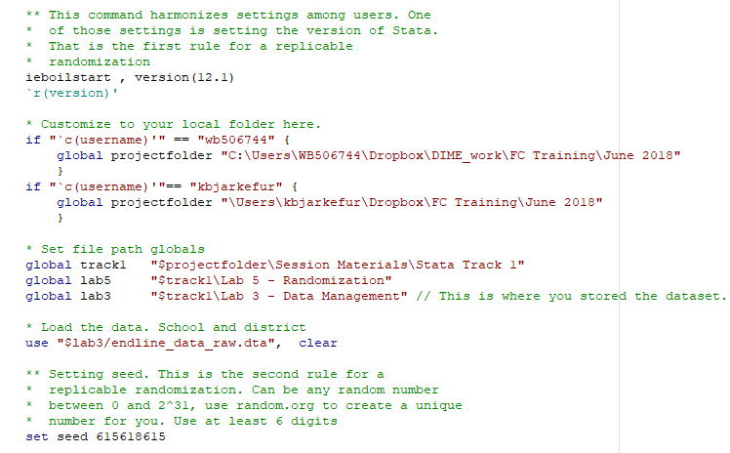
Ex 1: Basic Randomization in Stata
Rule 1: Set version
Load data
Rule 2: Set seed

Slide 21
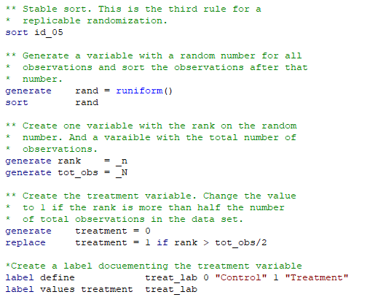
Ex 1: Basic Randomization in Stata
Rule 3: Stable sort
Generate random number and sort
Variables used in assignment
Assign to treatment if rank is less then half
Label the variable

Slide 22
Ex 2: Randomization in Stata
Multiple treatment arms
We have 1067 households and we want one third of them to be control and two treatment arms with one third in each

Slide 23
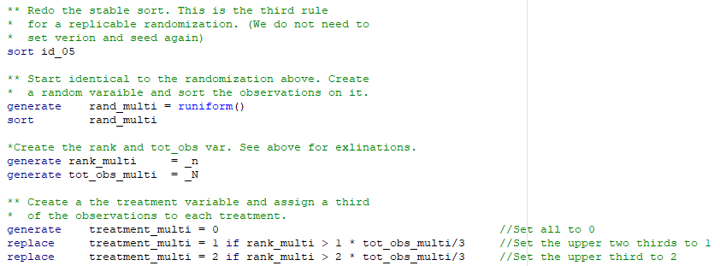
Ex 2: Randomization in Stata
Similar to Ex 1, but we assign the households to 4 groups

Slide 24
Real life issues
The example we have covered here is a school book example, but in real life, there are many common issues that makes randomization more complicated
There are commands that take care of these types of issues. Among them we recommend randtreat. To use this in a real life example, see track 2
But if you do not understand the school book example, you are likely to not know how to use randtreat properly

Slide 25
Common Issues
Differently sized groups. For example 40% is control, and treatment arm 1 and 2 is 30% each – randtreat solves this
Stratification. Split up the observations into groups. Rich/Poor, Male/Female, regions, etc. and then do the randomization in each group – randtreat solves this
Uneven groups (for example, divide 20 observations in 8 groups). The number of observations is not evenly divisible with the number of treatment arms. How to deal with the left overs observation? All to control? All to treatment? – randtreat solves this

Slide 26
The 3 rules still apply to randtreat
Even if you are using randtreat you need to remember to apply the three rules for the randomization to be fully replicable:
Version
Seed
Sort

Slide 27
Additional Resources
Duflo, Glennerster, and Kremer Handbook
Useful for understanding types of randomization and reasons for randomizing
http://economics.mit.edu/files/806

Slide 28
Thank you!
Sakina Shibuya & Kristoffer Bjärkefur
20 June 2018

